Slide 1
Microeconomics for Business
Chapter 5 – Market Equilibrium
Taxes

Slide 2
Taxes
The govt levies taxes on many goods & services to raise revenue to pay for national defense, public schools, etc.
The govt can make buyers or sellers pay the tax.
The tax can be a % of the good’s price,
or a specific amount for each unit sold.
  For simplicity, we analyze per-unit taxes only.

Slide 3
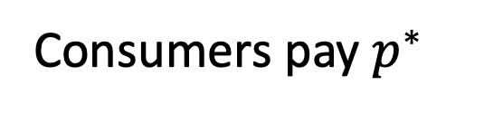
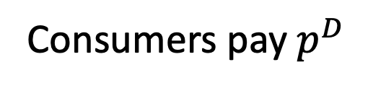
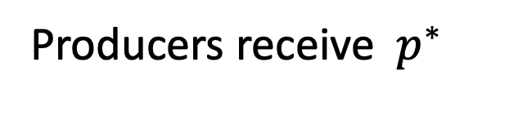

Modelling Taxes
Without government:
With Government:

Slide 4




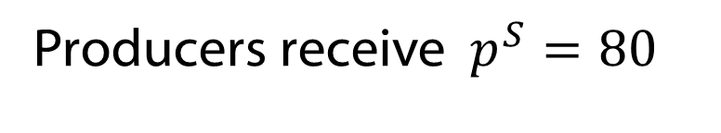
Taxes
“Per unit tax”
Examples: Cigarette Tax, Electronic Waste Recycling Fee, Fuel Tax, Alcoholic Beverage Tax

Slide 5
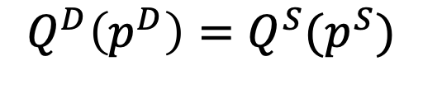
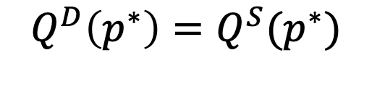

Taxes
Equilibrium
Without Government:
With Government:

Slide 6
Lesson 1: It doesn’t matter who physically pays the tax

Slide 7
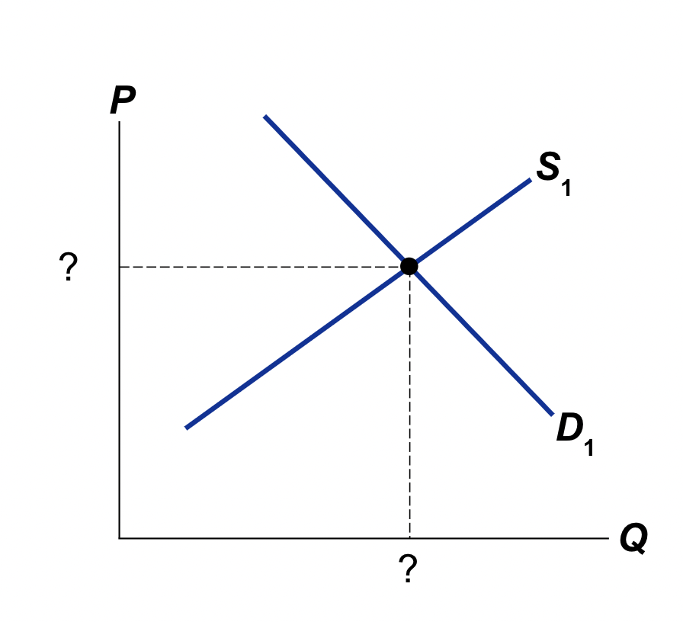
Example
P^{D}=20-(⅕)Q^{D} (Demand)
P^{S}=5+(1/10)Q^{S} (Supply)

Slide 8
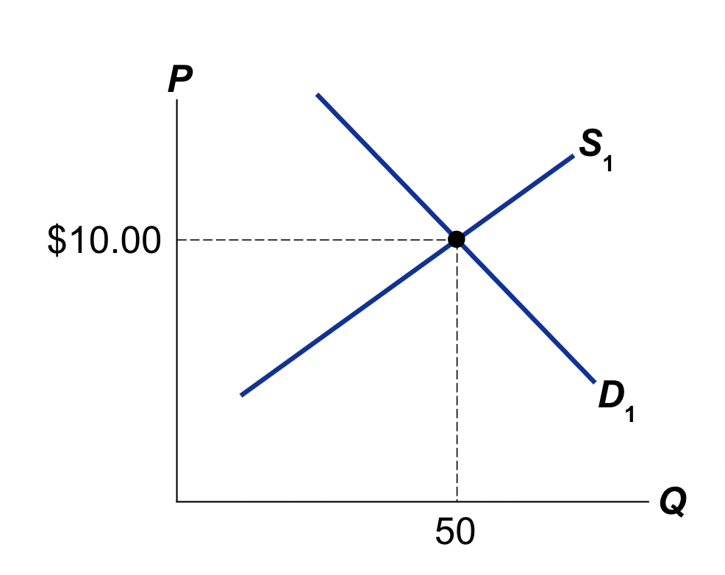
Example
P^{D}=20-(⅕)Q^{D} (Demand)
P^{S}=5+(1/10)Q^{S} (Supply)
20-(⅕)Q=5+(1/10)Q
15=(3/10)Q
Q=50 -> P=10

Slide 9
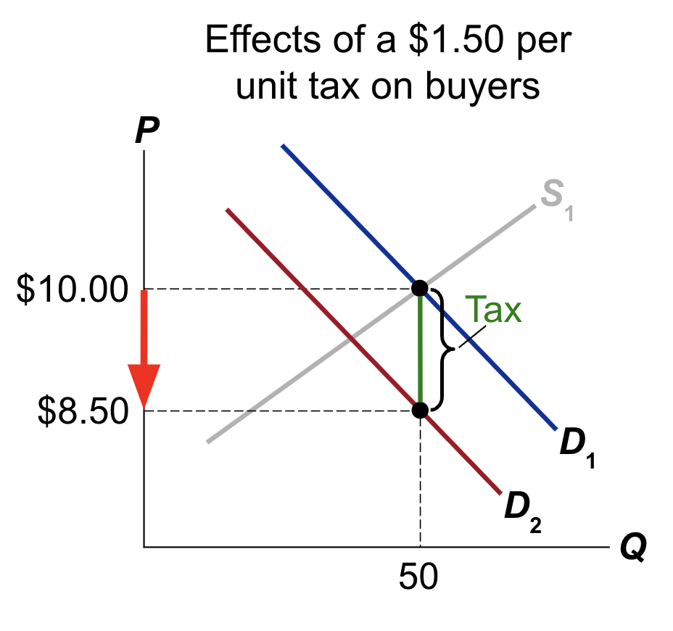
New buyer’s price with tax–
P^{D}=P^{S}+$1.50
P^{D}=20-(⅕)Q^{D}
P^{S}+1.50=20-(⅕)Q^{D}
P^{S}=18.5-(⅕)Q^{D}

Slide 10
a tax on buyers shifts the D curve down by the amount of the tax.

Slide 11
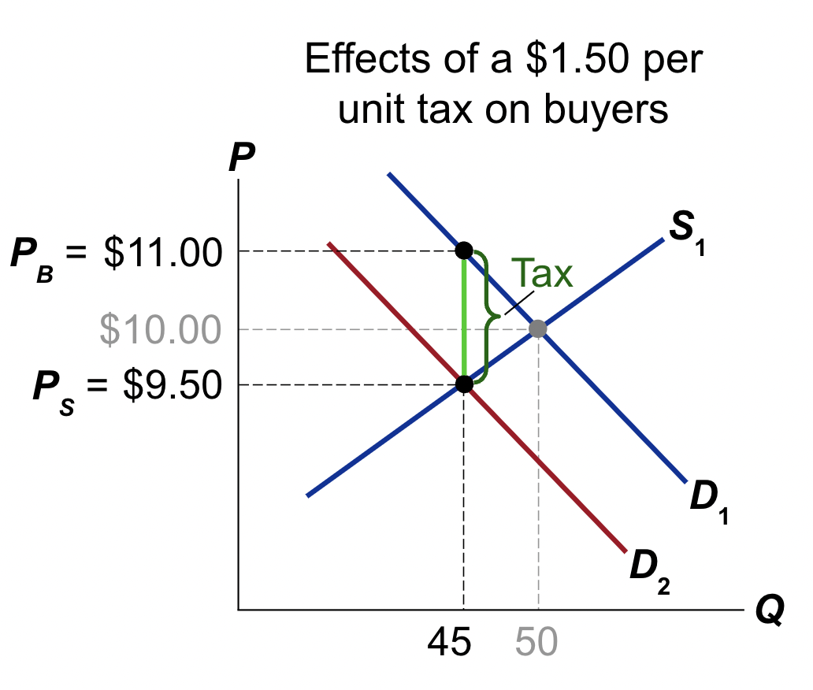
P^{S}=18.5-(⅕)Q^{D}
P^{S}=5+(1/10)Q^{S}
18.5-(⅕)Q=5+(1/10)Q
13.5=(3/10)Q
Q=(10/3)13.5=45 -> new quantity after tax

Slide 12
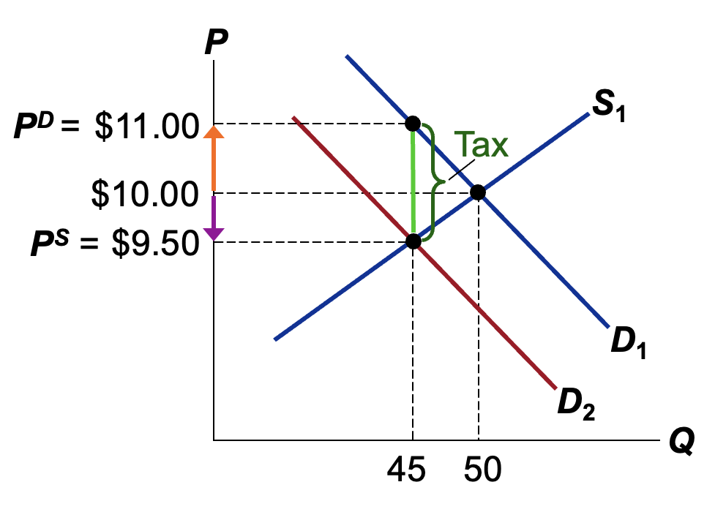
P^{S}=5+(1/10)Q^{S}
P^{S}=5+(1/10)(45)=9.5
P^{D}=P^{S}+tax=9.5+1.5=11
Buyers pay $1.00 more
Sellers get $0.50 less

Slide 13
Example part 2
P^{D}=20-(⅕)Q^{D} (Demand)
P^{S}=5+(1/10)Q^{S} (Supply)
Now, let’s put the $1.50 tax on the sellers
P^{S} = P^{D} - Tax
P^{S}=P^{D}- 1.50
Can you solve for the new equilibrium?

Slide 14
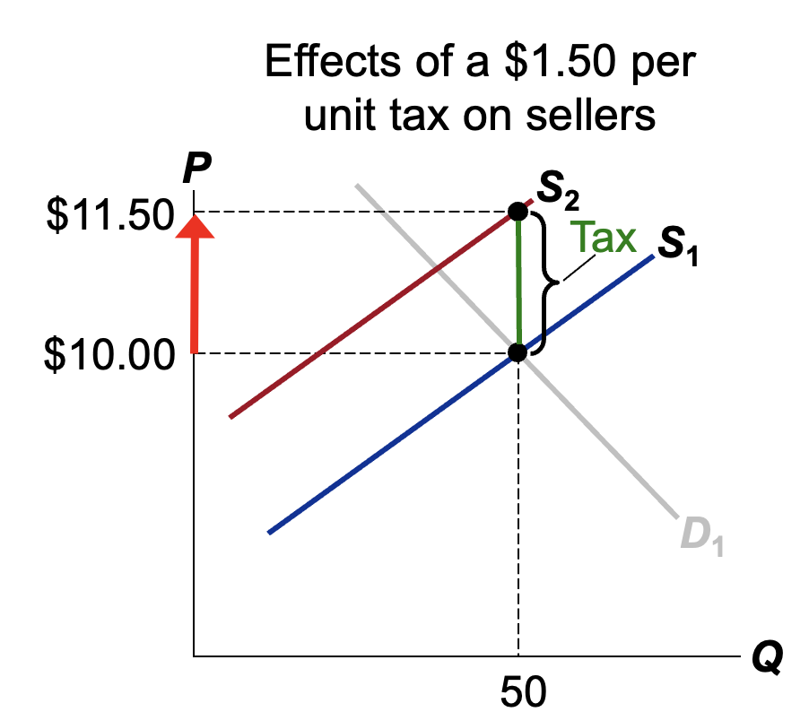
New Supply Curve
P^{S}=5+(1/10)Q^{S}
P^{D}-1.50=5+(1/10)Q^{S}
P^{D}=6.50+(1/10)Q^{S}

Slide 15
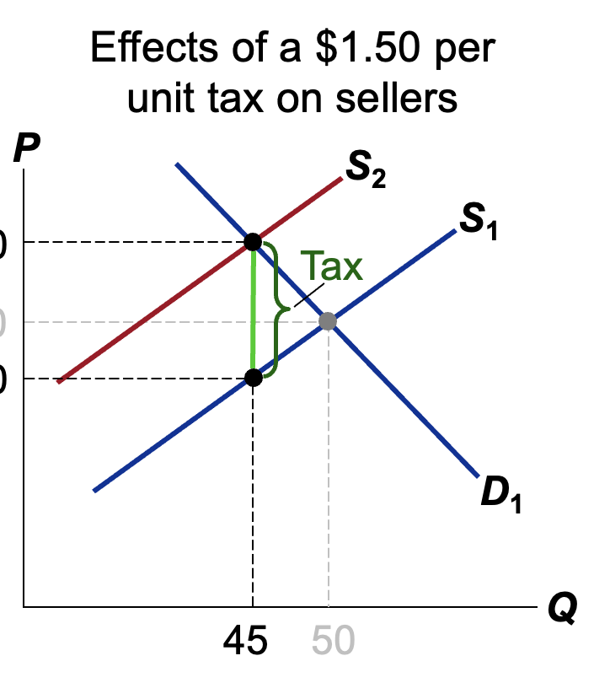
New Supply Curve
P^{D}=6.50+(1/10)Q^{S}
Demand Curve:
P^{D}=20-(⅕)Q^{D}
New eq:
6.5+(1/10)Q=20-(⅕)Q
(3/10)Q=13.5
Q=45

Slide 16
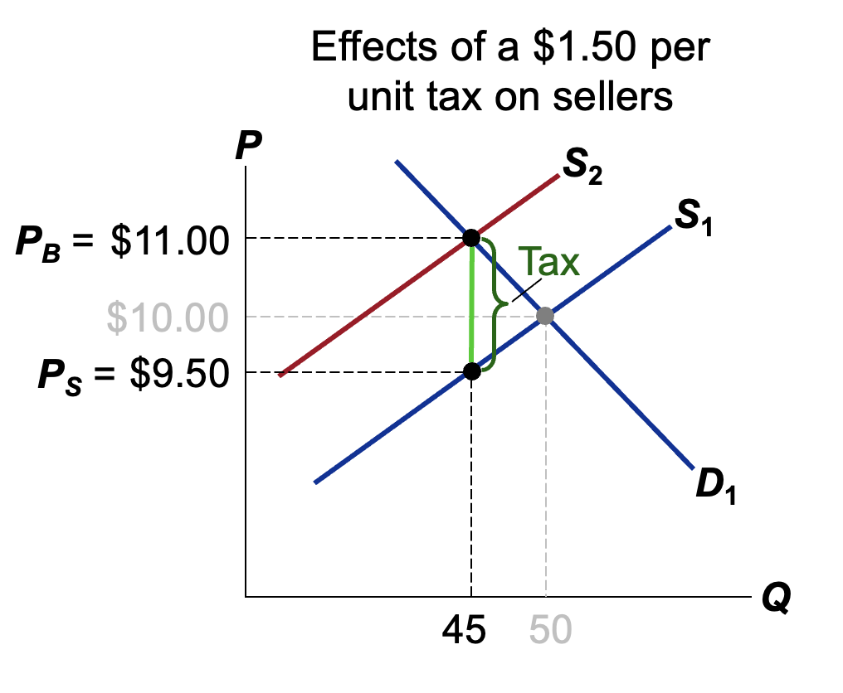
Demand Curve:
P^{D}=20-(⅕)Q^{D}
P^{D}=20-(⅕)45=11
P^{s}=P^{D}-1.5=9.5

Slide 17
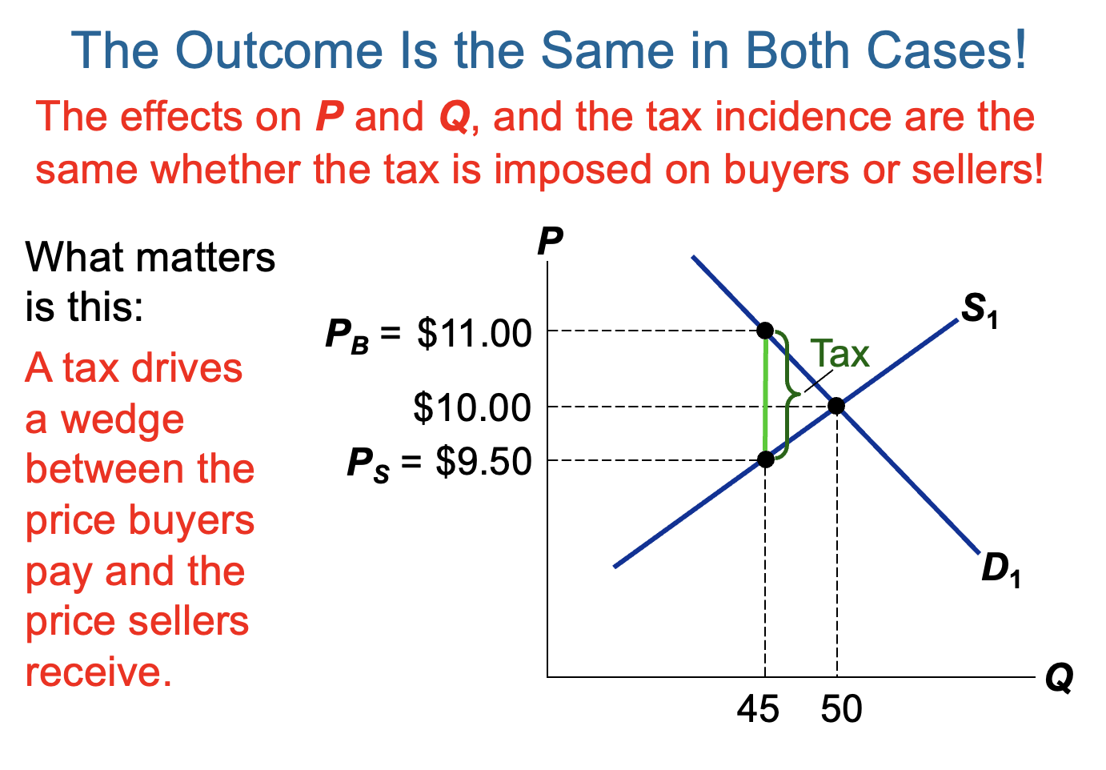

Slide 18
Intuition
Tax levied on consumers:
  Some of the burden is passed to producers since people are willing to pay less for the good now that it has a tax associated with it.
Tax levied on a business:
  The firm will raise prices and pass some of the burden to consumers.
Incidence:
  Incidence is the same.

Slide 19
Lesson 2: Taxes raise revenue for government but lower the size of the overall pie (surplus).

Slide 20
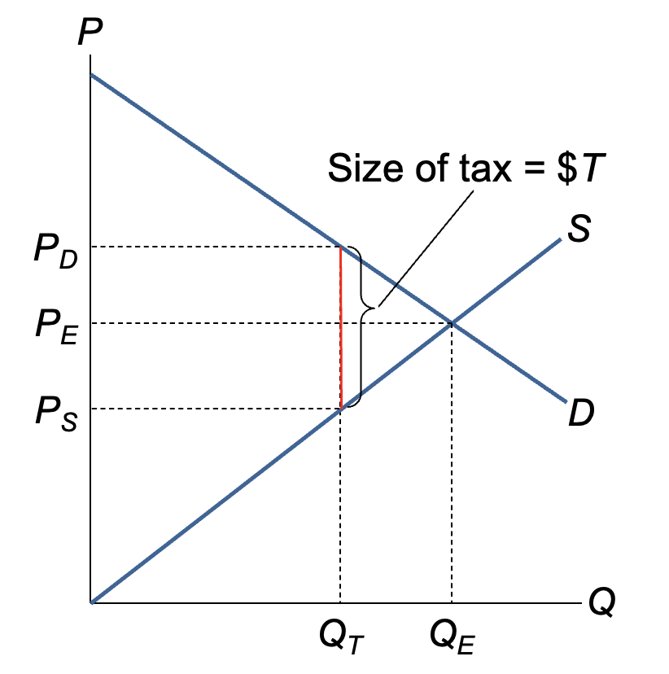
Eq’m with no tax:
Price = P_{E}
Quantity = Q_{E}
Eq’m with
tax = $T per unit:
Buyers pay P_{D}
Sellers receive P_{S}
Quantity = Q_{T}

Slide 21
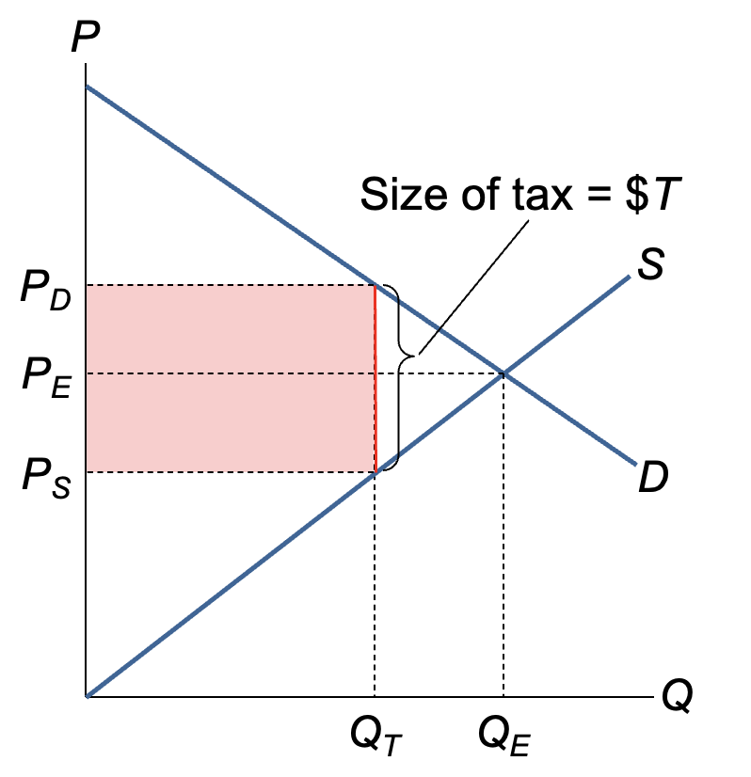
Revenue from tax: $T x Q_{T}

Slide 22
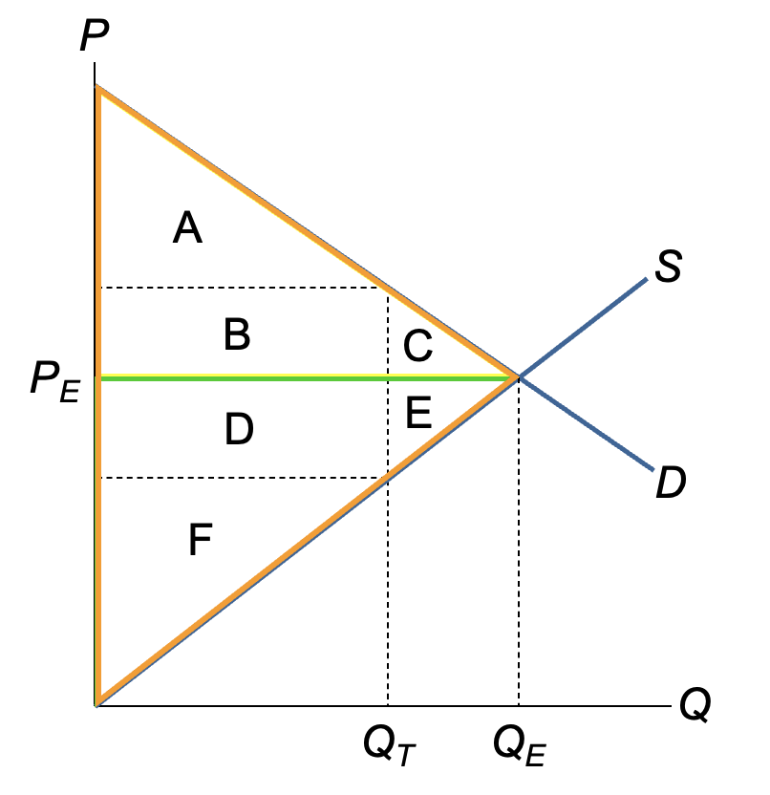
No Tax
CS: ABC
PS: DEF
Tax Revenue: Zero
TOTAL SURPLUS: ABCDEF

Slide 23
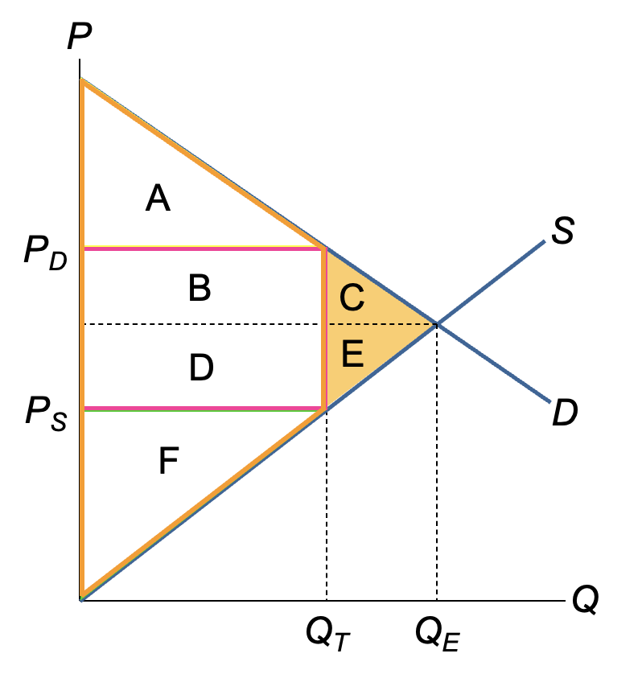
Tax
CS: A
PS: F
Tax Revenue: BD
TOTAL SURPLUS: ABDF
CE is lost

Slide 24
C + E is called the deadweight loss (DWL) of the tax, the fall in total surplus that
results from a market distortion, such as a tax.

Slide 25
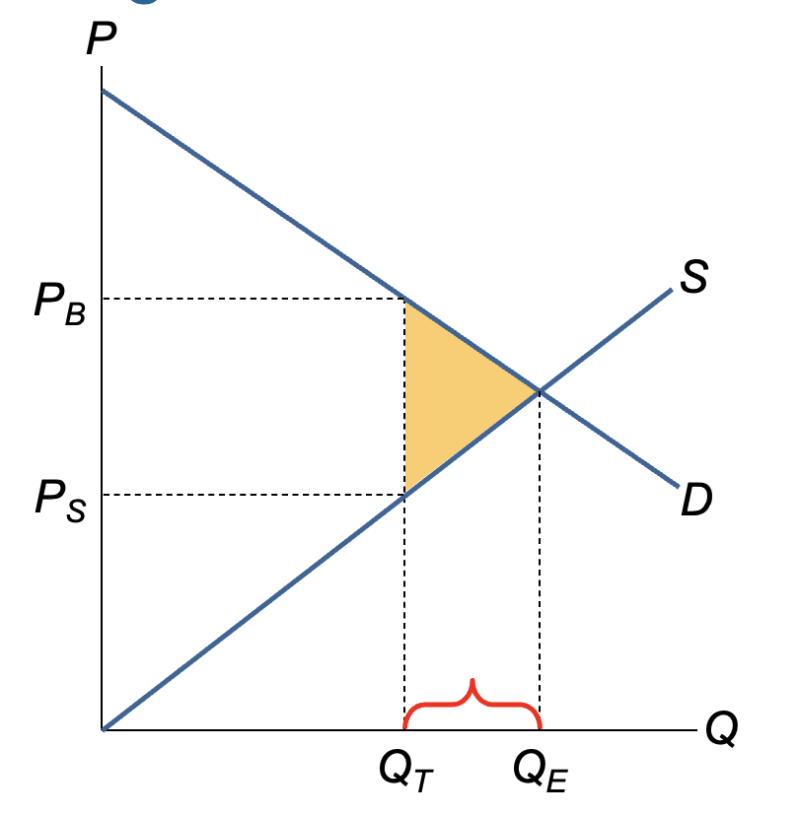
Because of the tax, the units between
Q_{T} through Q_{E} are not sold.
The value of these units to buyers is greater than the cost of producing them,
so the tax prevents some mutually beneficial trades.

Slide 26
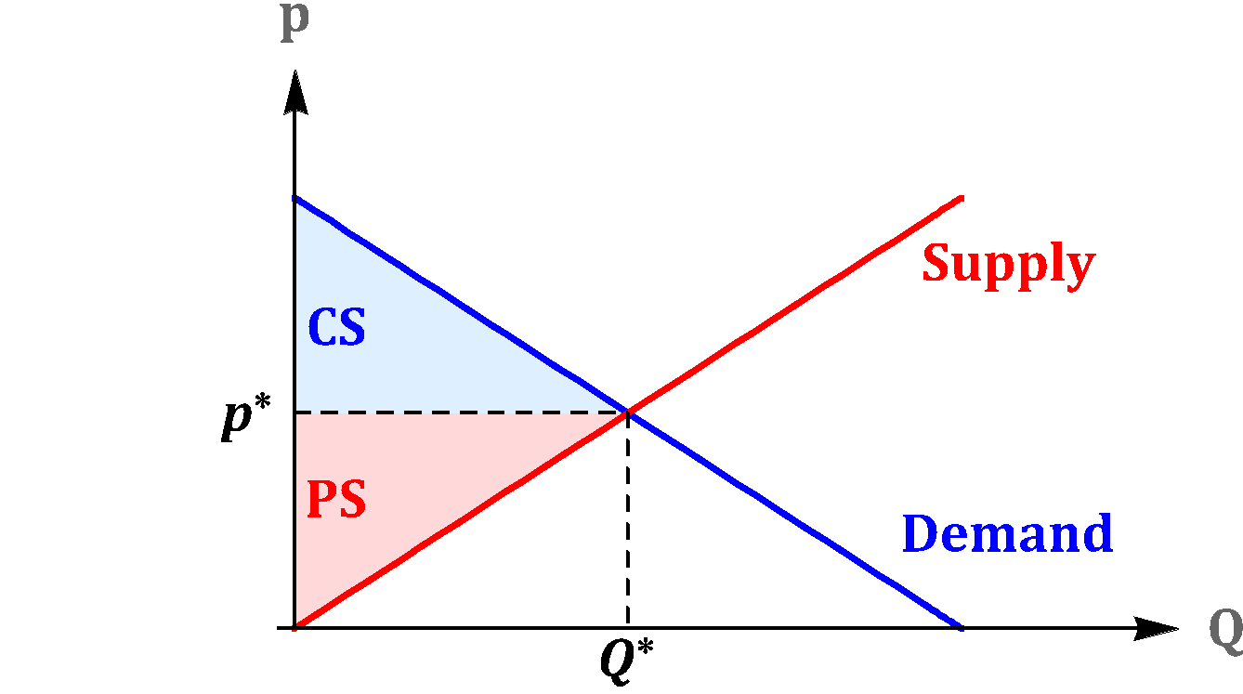
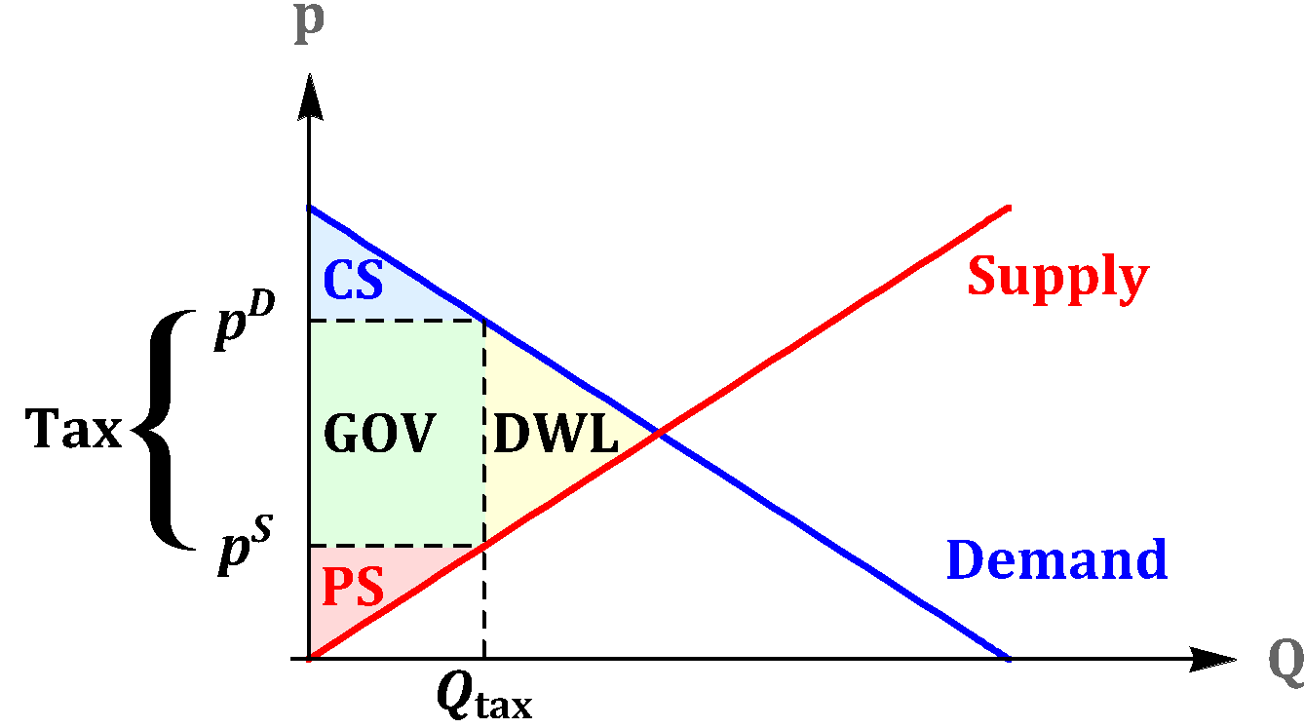
Taxes
Before Taxes
After Taxes

Slide 27
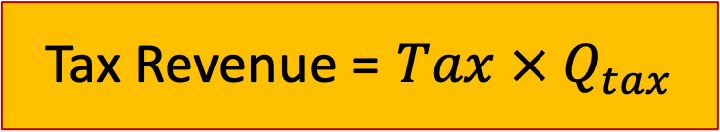
Taxes
Before Taxes
After Taxes

Slide 28
Taxes
Total Surplus = Consumer Surplus + Producer Surplus + Tax Revenue

Slide 29
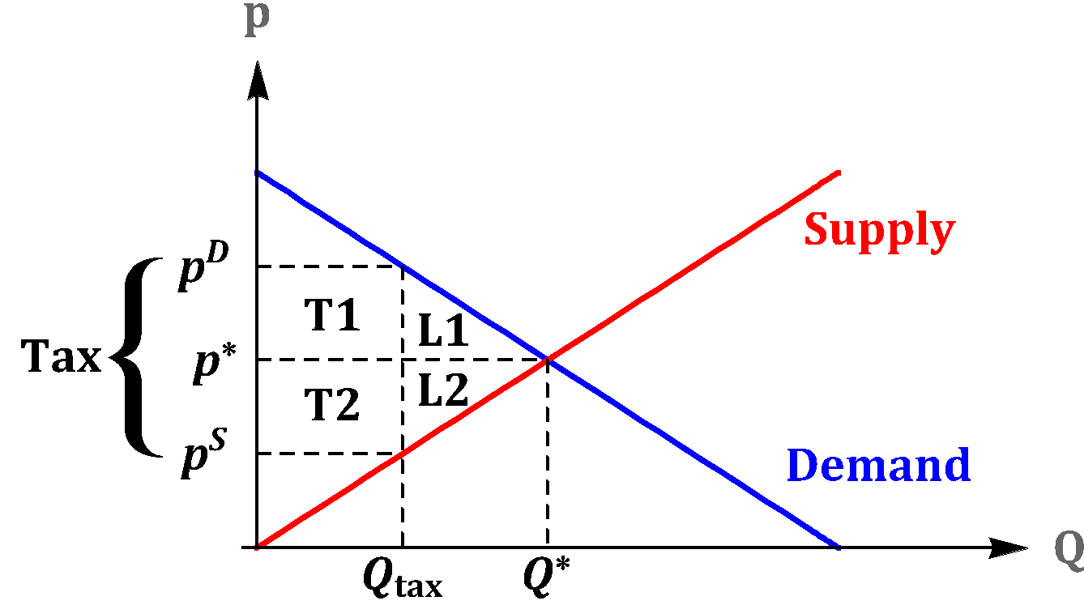
Taxes
Consumers lose T1 + L1 and Producers lose
T2 + L2. Government gains T1 + T2.
Before Taxes
After Taxes
Change

Slide 30

Guess the tax?

Slide 31

Guess the tax?

Slide 32

Guess the tax?
Notes:
https://twitter.com/page_eco/status/1230459189270466562/photo/4

Slide 33
Lesson 3: Elasticity determines who bears the burden of the tax

Slide 34
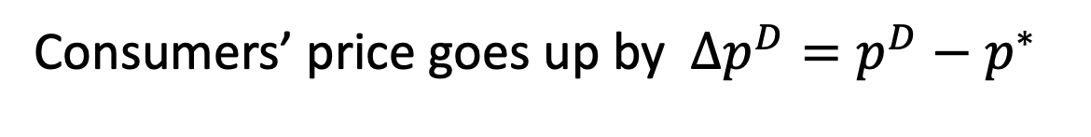
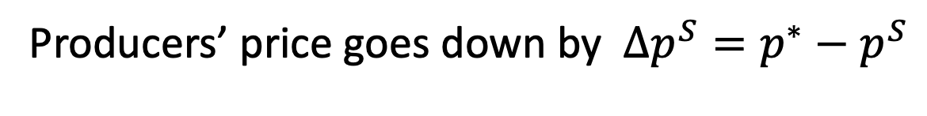
Taxes
Tax Burden
Who will carry the highest tax burden?

Slide 35
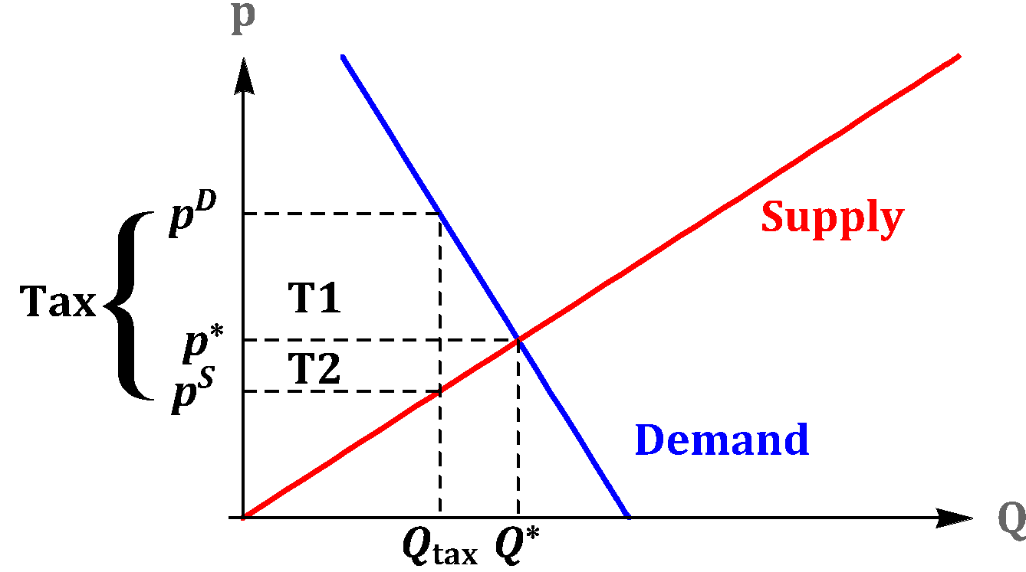
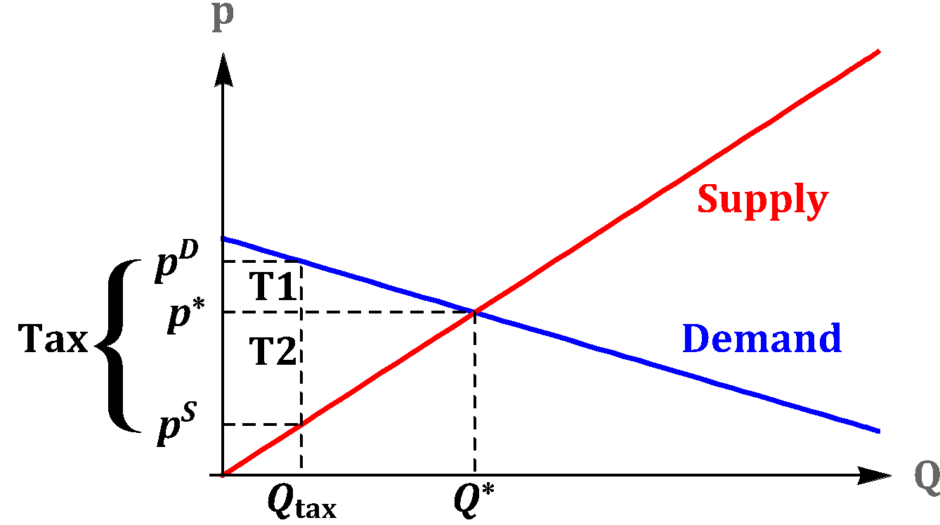
Taxes
Most Tax Burden on Consumers
Most Tax Burden on Producers

Slide 36
Taxes
Most Tax Burden on Consumers
Most Tax Burden on Producers
The demand function is relatively more inelastic than the supply
The supply function is relatively more inelastic than the demand

Slide 37


Slide 38
https://www.youtube.com/watch?v=1WRDwCep25k&list=PLBuns9Evn1w9XhnH7vVh_7C65wJbaBECK&index=9

Slide 39
Taxes
Consumers and producers equally share the tax burden.
Same elasticities (in absolute values).

Slide 40
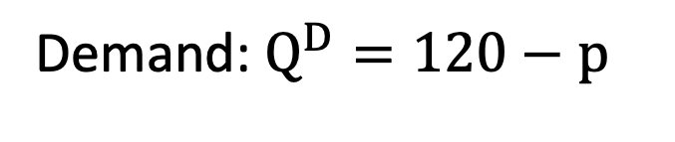


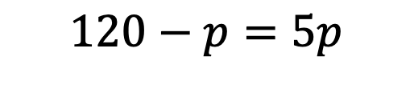

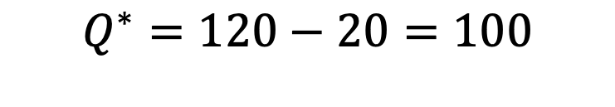
Taxes
Exercise
Equilibrium

Slide 41
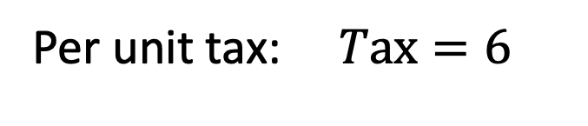

Taxes
Exercise
Equilibrium

Slide 42
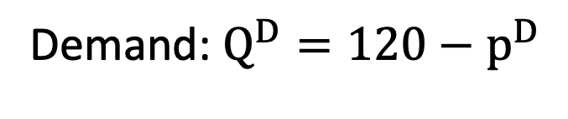

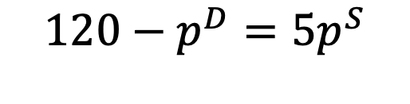


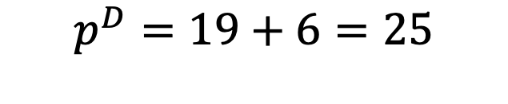
Taxes
Exercise
Equilibrium

Slide 43
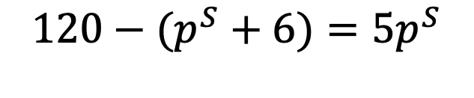
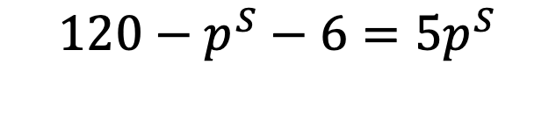
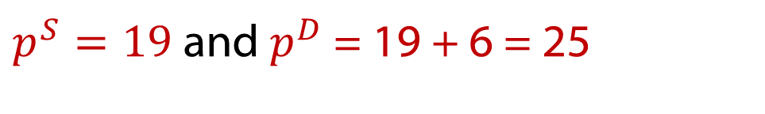

Taxes
Exercise
Equilibrium

Slide 44


Taxes
Exercise
Equilibrium

Slide 45
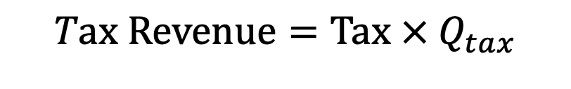
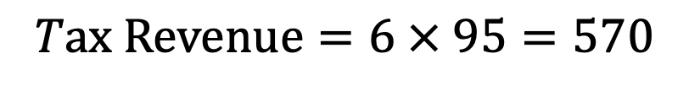
Taxes
Exercise

Slide 46







Taxes
Exercise
Before
After

Slide 47
Question
P=150-0.5Q^{D} -> Demand
P=Q^{S} -> Supply
Tax = $30
Find P^{D} and P^{S} after tax, government revenue and deadweight loss, who bears more of the burden?

Slide 48
Lesson 4: Elasticity determines the size of the deadweight loss

Slide 49
Question
What should be taxed?

Slide 50
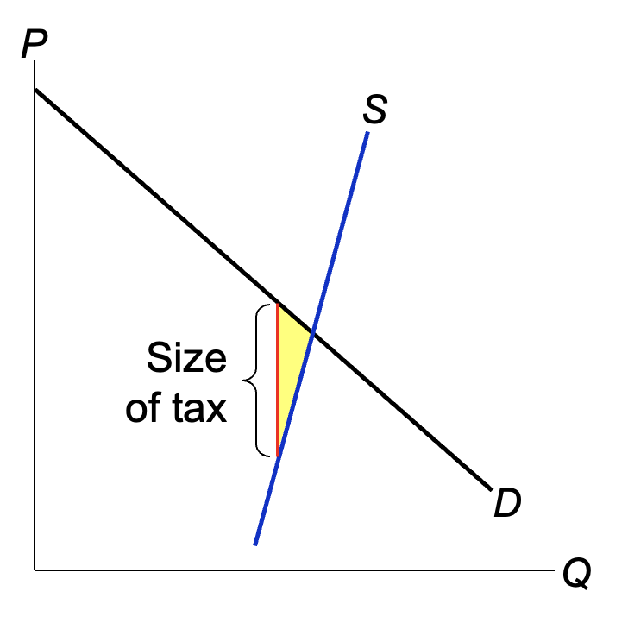
When supply is inelastic,
it’s harder for firms to leave the market when the tax reduces P_{S}.
So, the tax only reduces Q a little,
and DWL is small.

Slide 51
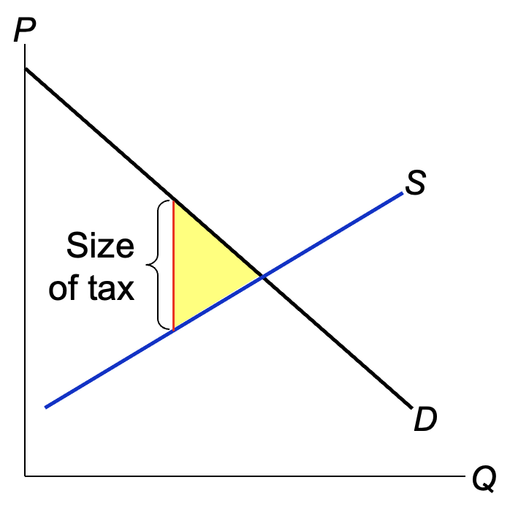
The more elastic is supply,
the easier for firms
to leave the market when the tax reduces P_{S},
the greater Q falls below the surplus-maximizing quantity,
the greater the DWL.

Slide 52
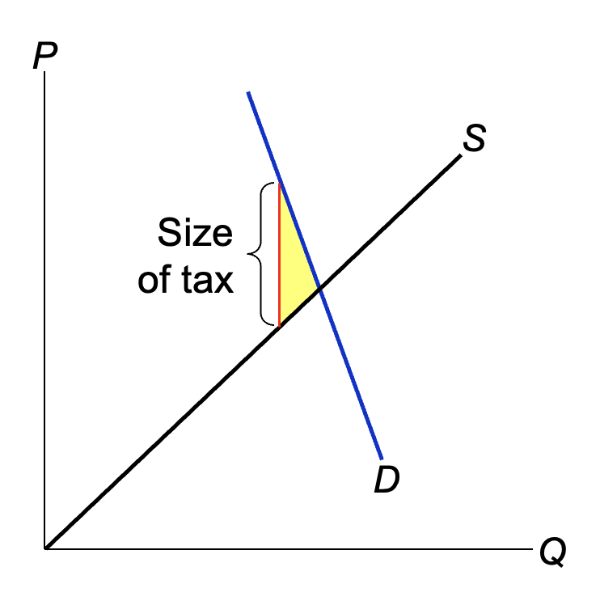
When demand
is inelastic,
it’s harder for consumers to leave the market when the tax raises P_{B}.
So, the tax only reduces Q a little,
and DWL is small.

Slide 53
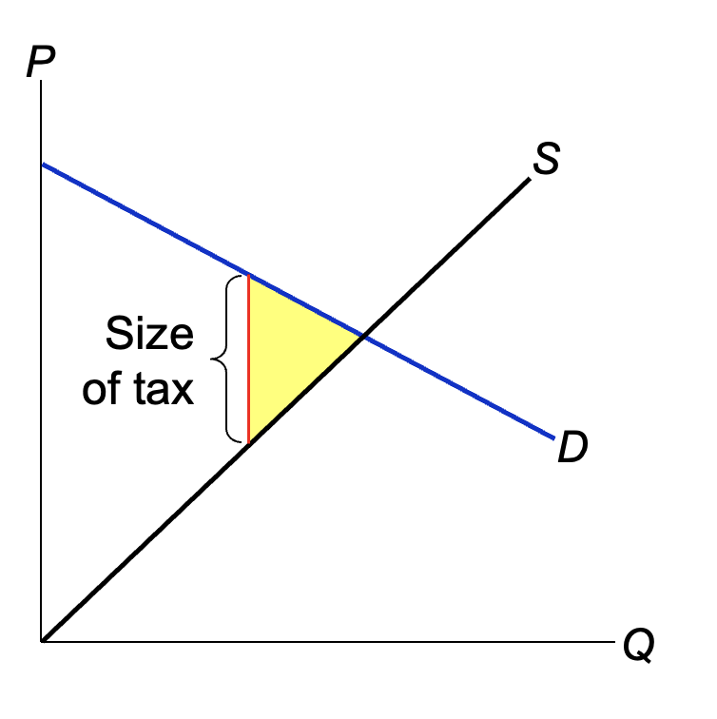
The more elastic is demand,
the easier for buyers to leave the market when the tax increases P_{B},
the more Q falls below the surplus-maximizing quantity,
and the greater the DWL.

Slide 54

What is taxed–
https://practice.mru.org/guessrevenue/

Slide 55
Is Labor Supply elastic or inelastic?

Slide 56
Lesson 5 – The contentious relationship between tax rates and tax revenue

Slide 57
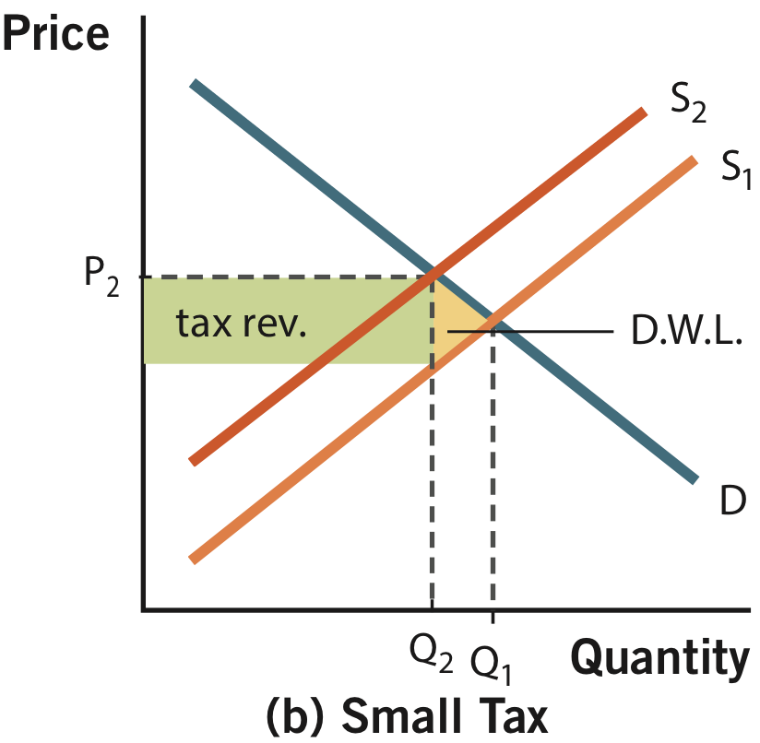

Slide 58
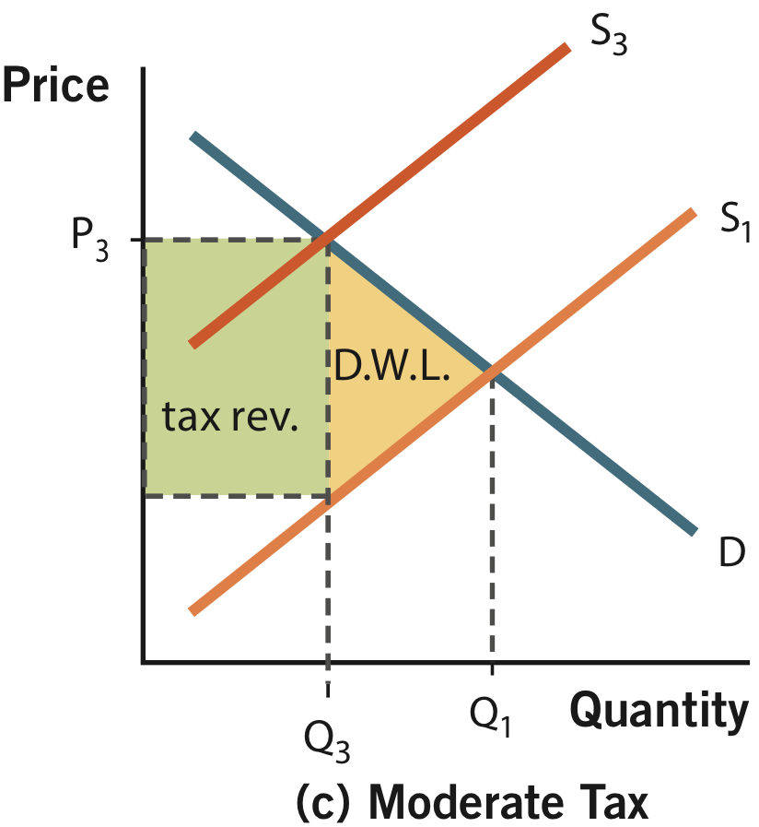

Slide 59
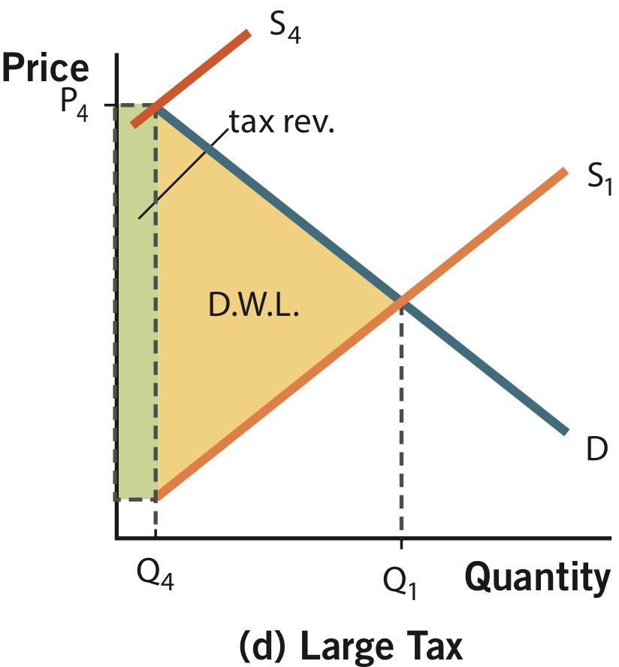

Slide 60
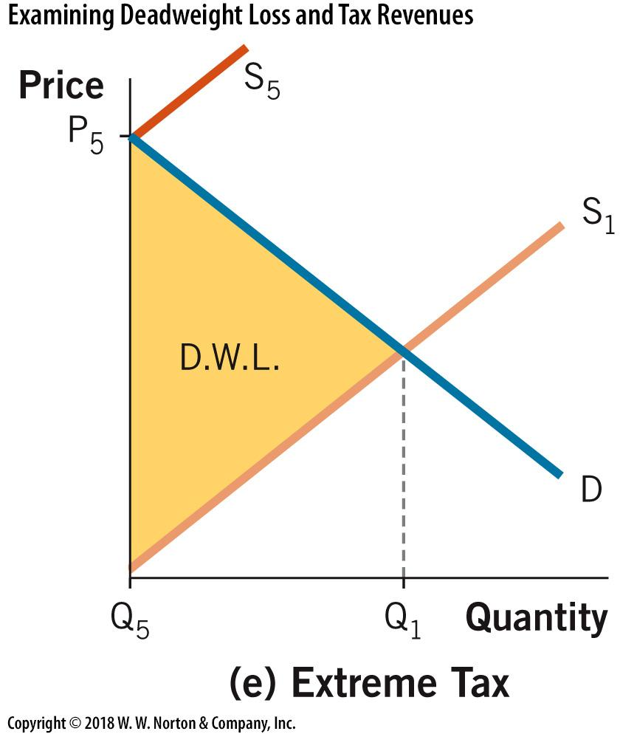

Slide 61
Revenue and the Size of the Tax
The Laffer curve shows the theoretical relationship between
the size of the tax and tax revenue.
The Laffer curve
Tax revenue
Tax size
Notes:
‹#›
The Laffer curves shown here and in the book are symmetric, and their peak occurs in the middle. You might mention to students that this need not and probably is not the case. However, we just don’t know where the peak is—it could be at a tax rate of 20% or a tax rate of 200%—and it surely varies across goods.
The textbook has some excellent discussion of the Laffer curve, President Reagan, and supply-side economics. Encourage your students to check it out.

Slide 62

https://play.storylinegame.com/play?quiz=MRU%20Tax

Slide 63
Microeconomics for Business
Chapter 5 – Market Equilibrium
Subsidies

Slide 64
Subsidies
Without government:
With Government:

Slide 65


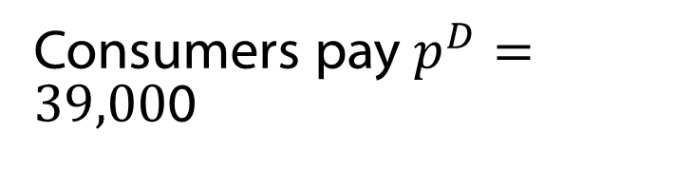

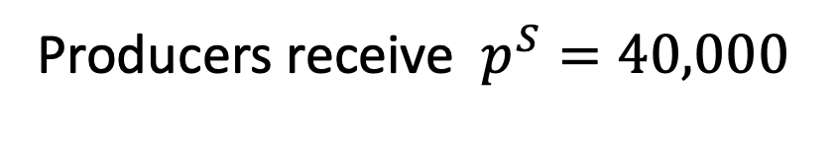
Subsidies
“Per unit subsidy”
Example: California’s Clean Vehicle Rebate Project

Slide 66

Subsidies
Equilibrium
Without Government:
With Government:

Slide 67

Subsidies
Gain in CS = T2, Gain in PS = T1, Subsidy cost to government = L + T1 + T2.
Before Taxes
Change

Slide 68
Subsidies
Who gets the most benefit from the subsidy, producers or consumers?
Consumers if the demand function is relatively more inelastic than the supply
Producers if the supply function is relatively more inelastic than the demand

Slide 69


Slide 70



Slide 71



Slide 72

Subsidies
Exercise
Equilibrium

Slide 73



Subsidies
Exercise
Equilibrium

Slide 74


Subsidies
Exercise

Slide 75






Subsidies
Exercise
Before
After

Slide 76


